Slide 1

InsituMicron
Innovation at microscale

Slide 2
InsituMicron
About Us
Incubated by the researchers from IIT Madras, India, we are a scientific instrumentation company specializing in miniature mechanical testing and in situ characterization technologies.
With years of experience and scientific know-how in the design and development of machines along with customized software and In situ mechanical testing, we aim to serve the needs of academic institutions, national labs, R&D centers, and industries worldwide.
With their compact and modular design, our technologies are both standalone models and as well can be integrated with some of the high-end characterization machines to carry out intelligent experiments which would result in breakthrough findings.
Vision
To be a global scientific instrumentation brand and drive the transition towards the state-of-the-art next generation characterization instruments which can accelerate research to solve global problems.
Mission
Our mission is to develop and democratize miniature mechanical testing and in situ characterization solutions and use the technologies as a tool to progress the frontiers of science and technology. We strive to achieve excellence through ingenuity and innovation.

Slide 3







InsituMicron
The Team
Ravi Kumar
Professor,
IITM
Founder
Lalith Kumar Bhaskar
PhD graduate,
IITM
Founder
Kousik Papakollu
Joint PhD student,
IITM & TU Darmstadt
Co-Founder
Abishek M
PhD student,
IITM
Manager,
Business development and operations
Ankit Bansal
MS student,
IITM
Lead R&D engineer
Srinivasan N
Assistant Professor,
IIT Jammu
Advisor

Slide 4







InsituMicron
The need
Site specific testing
01
02
Identifying failure mechanisms
Miniaturized mechanical testing
In situ testing
Site specific testing of in service components
Characterization of materials mimicking the service conditions
Weldzone
Nuclear
Microscale analysis
Electronics
Additive Manufacturing
Aiding to unravel the unknown and contribute to ground-breaking research
Standard test specimens cannot be used!!!
Failure analysis
Problems
Current in situ technologies - Extremely costly
Lack of expertise
Indigenous products not available
Problems
Miniature samples should yield reliable results similar to standard specimens
Emerging market – require indigenously developed products
4 billion $ industry
Limited expertise

Slide 5
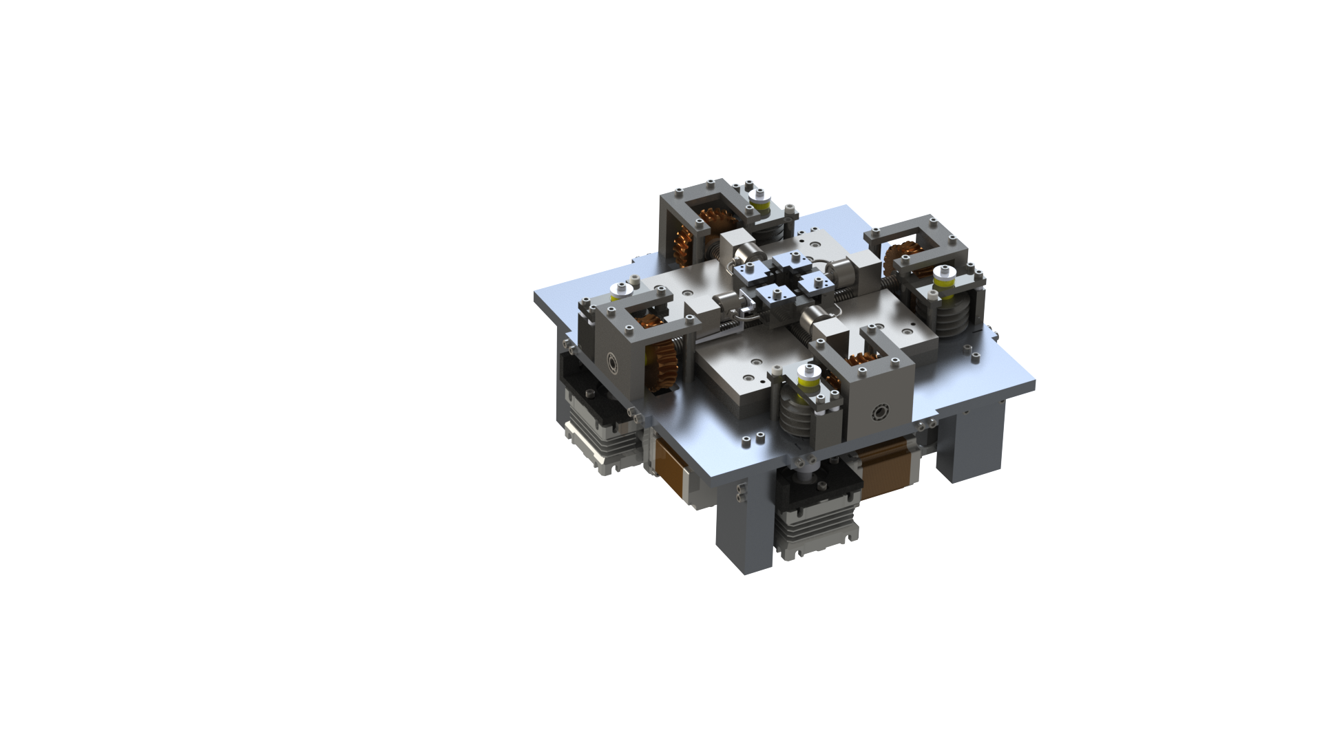









InsituMicron
The solutions
Multiaxial universal testing equipment (MUTE)
01
02
Miniature testing
In situ testing
Capable of testing miniature samples for
Can be integrated to
Compression
Biaxial compression
X-ray diffractometer
Optical microscope
Raman spectrometer
Tension
Biaxial tension
4-point bending
Products in pipeline
Failure analysis
Future objectives
Specialized solutions by experts for failure analysis and predictions
Use of AI/ML techniques for advanced failure analysis and predictions
Heating and cooling stages
In situ electron microscopy
In situ electro-chemistry
Torsion
Uniaxial fatigue
Biaxial fatigue
Indigenous software development for enhanced strain analysis and better experience

Slide 6
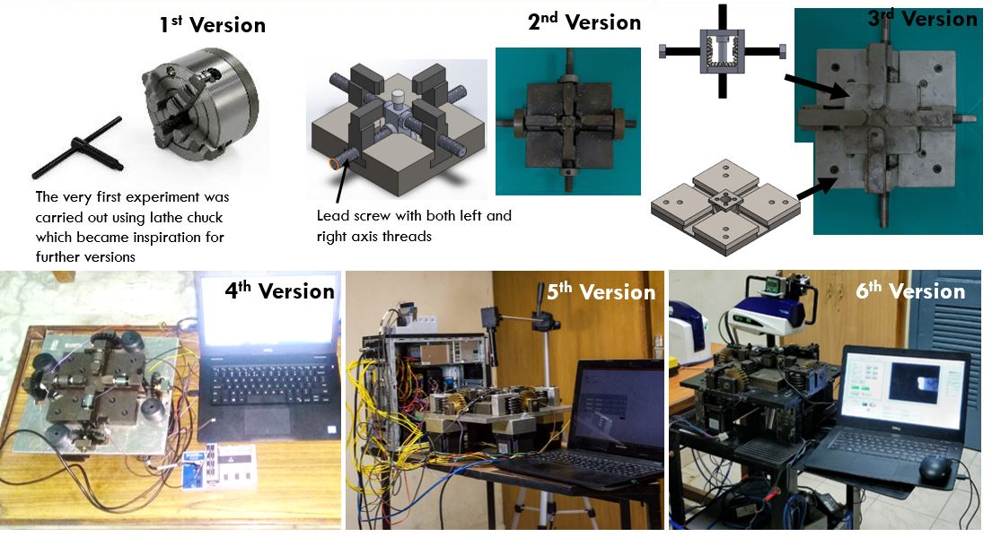
InsituMicron
Miniature multiaxial universal testing equipment (MUTE)
Evolution of prototypes

Slide 7
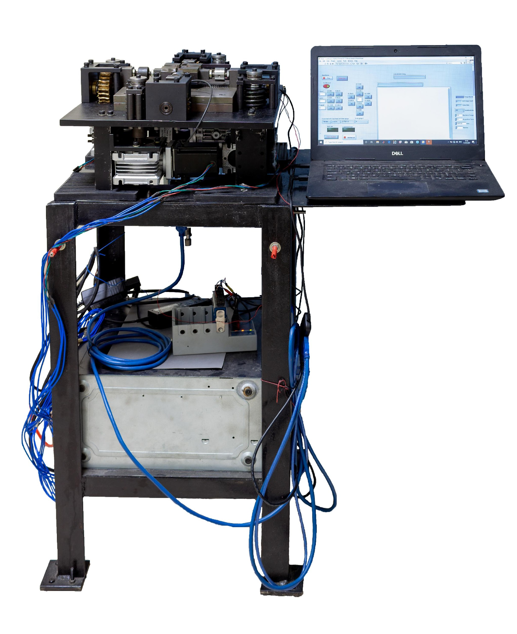
InsituMicron
Final prototype - (MUTE)
In situ multiaxial universal testing equipment
First of its kind
Indian filing: Application no. 202041012088 - Dated 20.03.2020
PCT filing: Application no. PCT/IN2021/050277 - Dated 18.03.2021
TRL – 9 (With little aesthetics improvement – Market ready condition)
Dimensions | 400 mm × 400 mm × 175 mm
Displacement stroke | 35mm/axes
Maximum loading capacity | 8000 N
Operational loading capacity | 7500 N
Minimum step size | 0.4 μm/axes
Cross head displacement rate
Loading rate | 2 N/s to 450 N/s
Customized graphical user interface - easy to use
To know more - https://www.youtube.com/watch?v=oMD-vMZfEZI

Slide 8
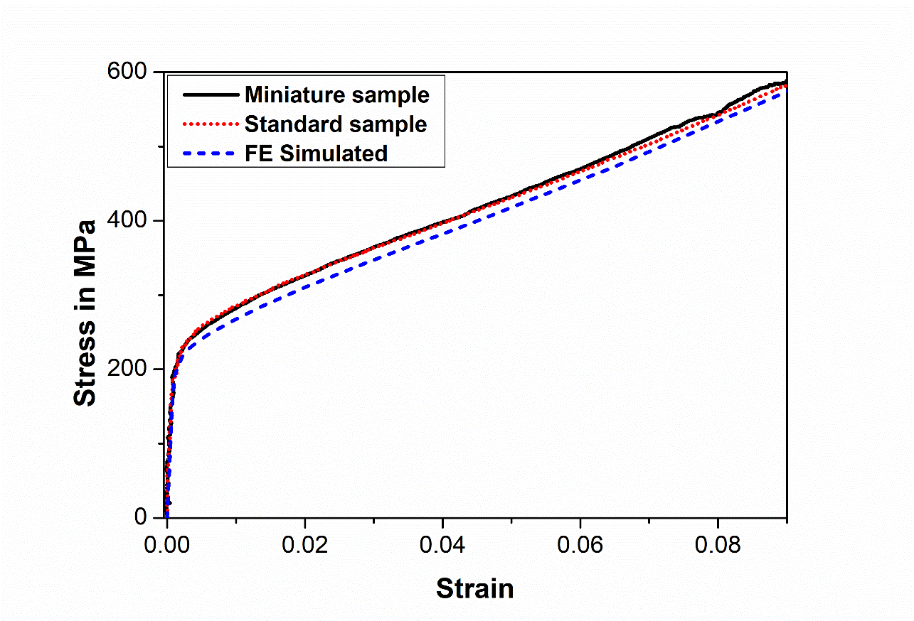
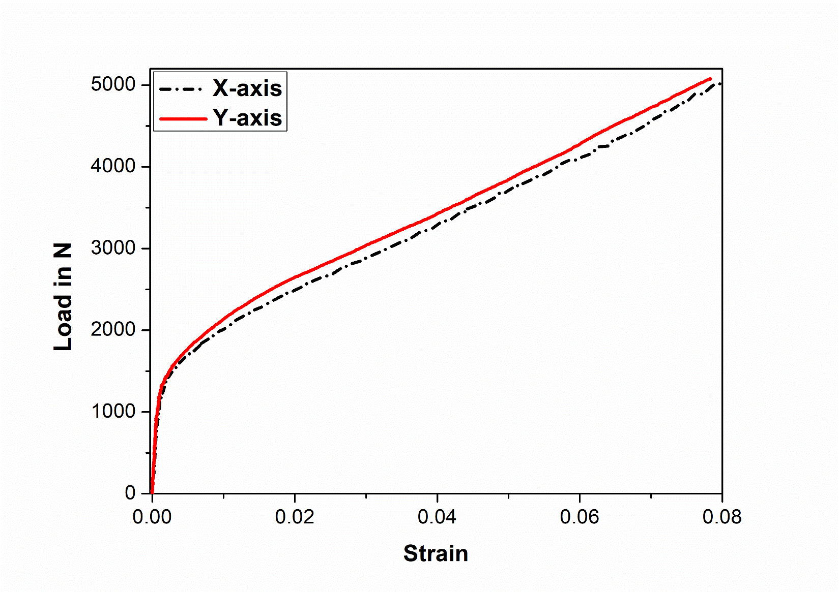
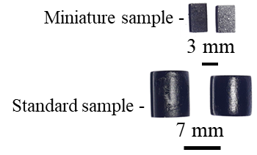
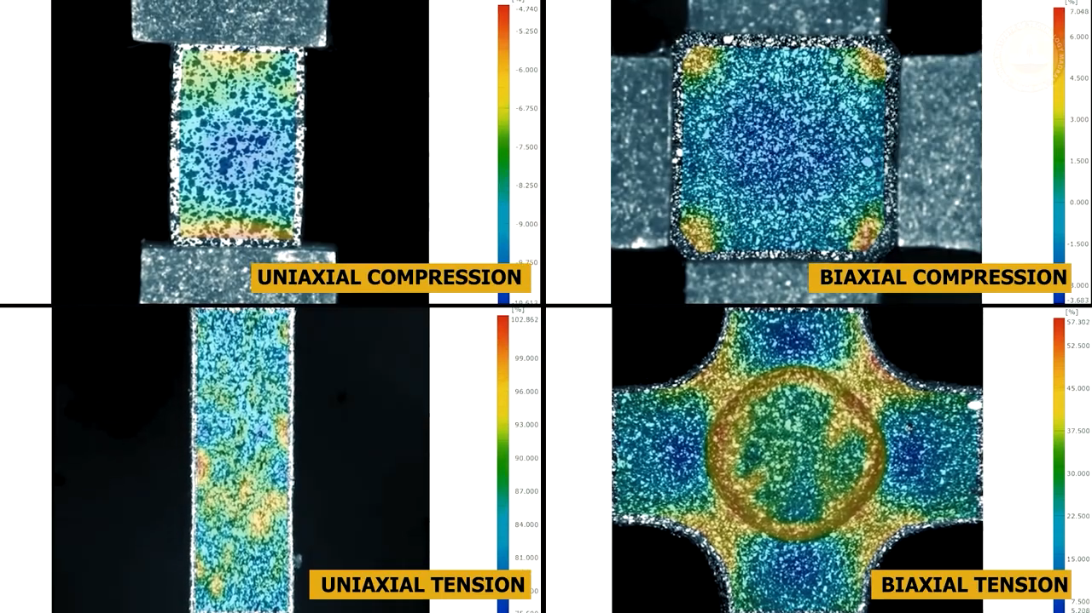
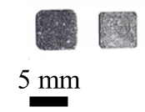
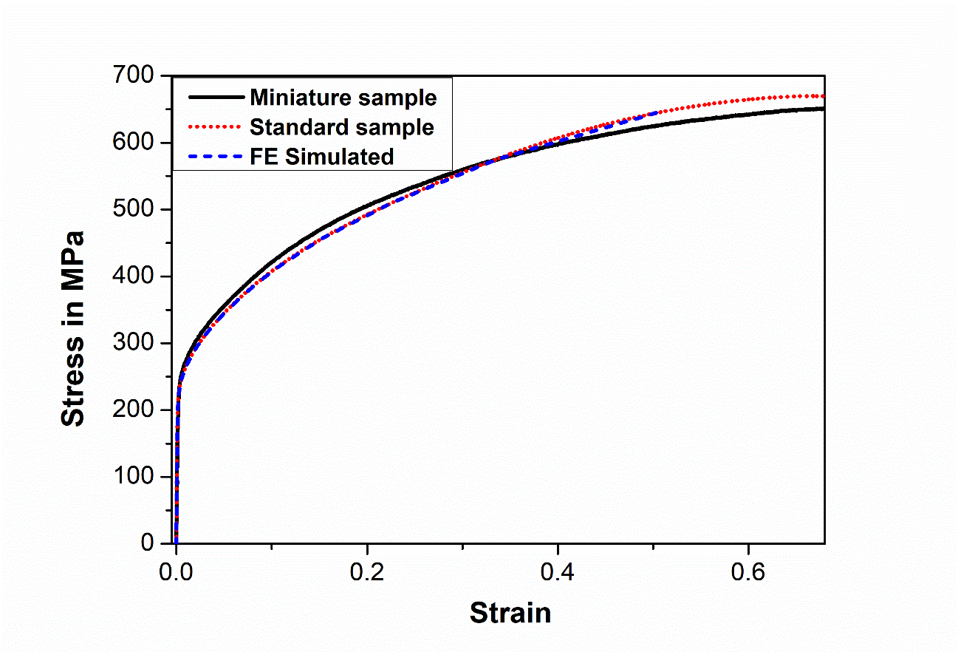
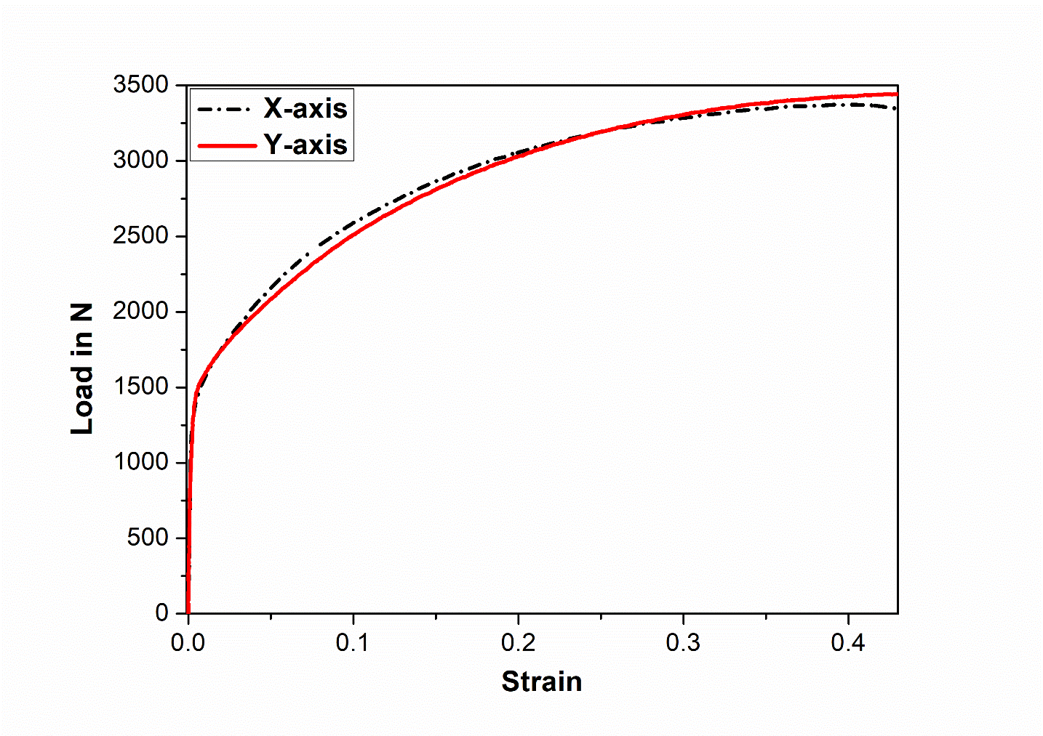
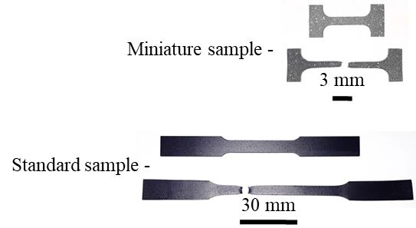
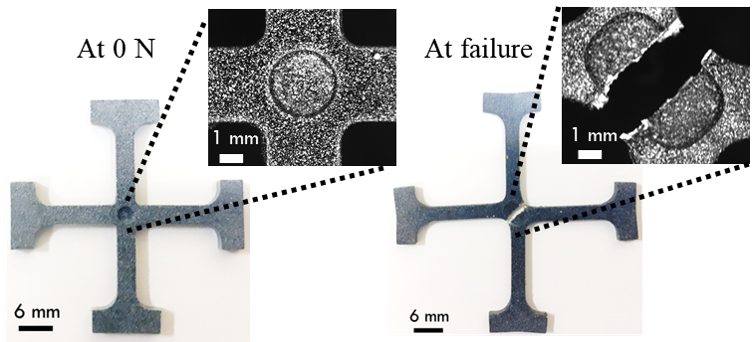
InsituMicron
Miniature sample testing- (MUTE)
Uniaxial Compression
Biaxial Compression
Samples were optimized for miniature testing
Full-field strain can be captured with ease
4-point bending experiments are also possible
A custom-built user friendly GUI with advanced controls
Uniaxial Tension
Biaxial Tension

Slide 9
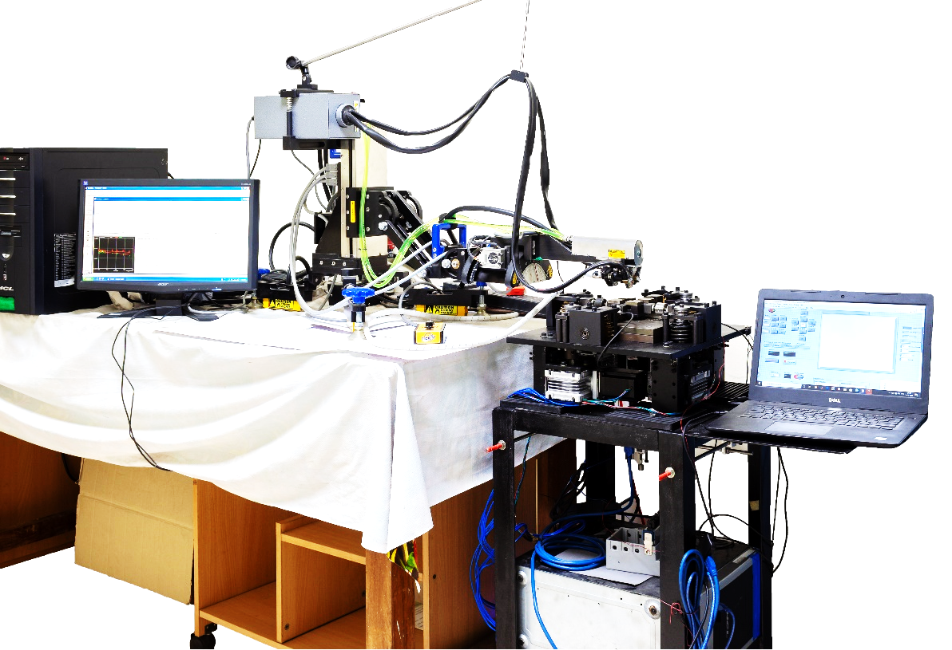
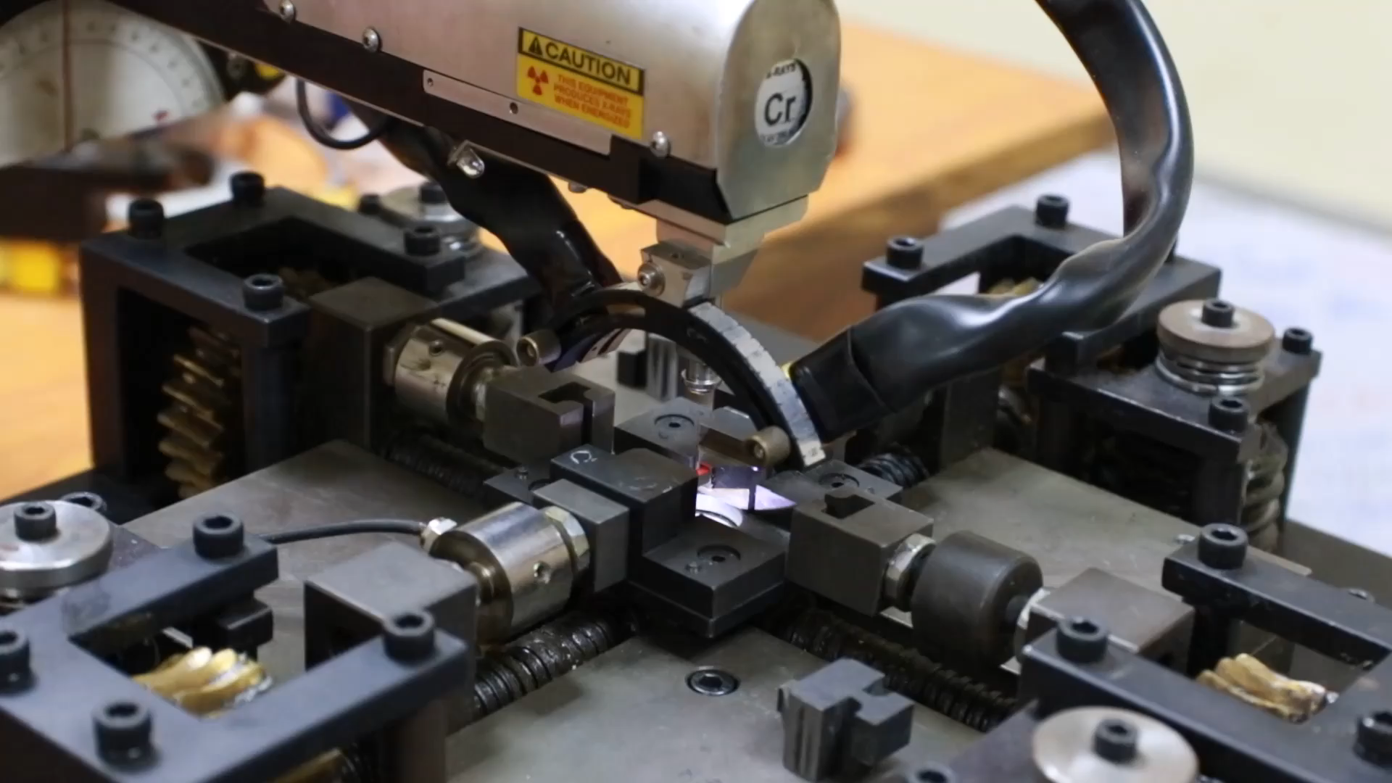
InsituMicron
In situ testing- (MUTE)
Integrated with a commercial X-ray diffractometer
First of its kind
Close up view
Can be integrated with a Raman spectrometer and an optical microscope as well
Further developments are underway to integrate it with a scanning electron microscope
For further information - https://www.youtube.com/watch?v=oMD-vMZfEZI & https://doi.org/10.1063/5.0031805

Slide 10

InsituMicron
Our competition
`
Gatan
($180 Million)
Deben
($3 Million)
EDEN Instruments
($4 Million)
Hysitron
($10 Million)
Almenis
($10 Million)
ADMET
($21 Million)
microMecha
($3 Million)
Kammrath and Weiss Technologies
($2 Million)
- In situ technologies
- In situ technologies + Miniature mechanical testing technologies

Slide 11
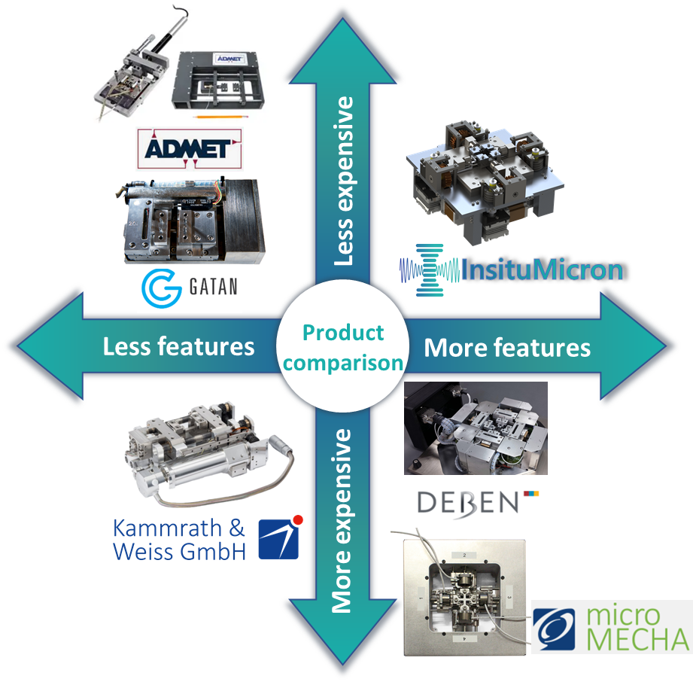



InsituMicron
Competition & sustenance
Sustenance
Established mechanical testing companies – Zwick Roell, Instron, MTS
Characterization companies – Proto, Thermo fischer, Oxford instruments
With companies and academic institutes specializing in In situ instruments
In-house dedicated team on design and development of next generation of testing instruments

Slide 12
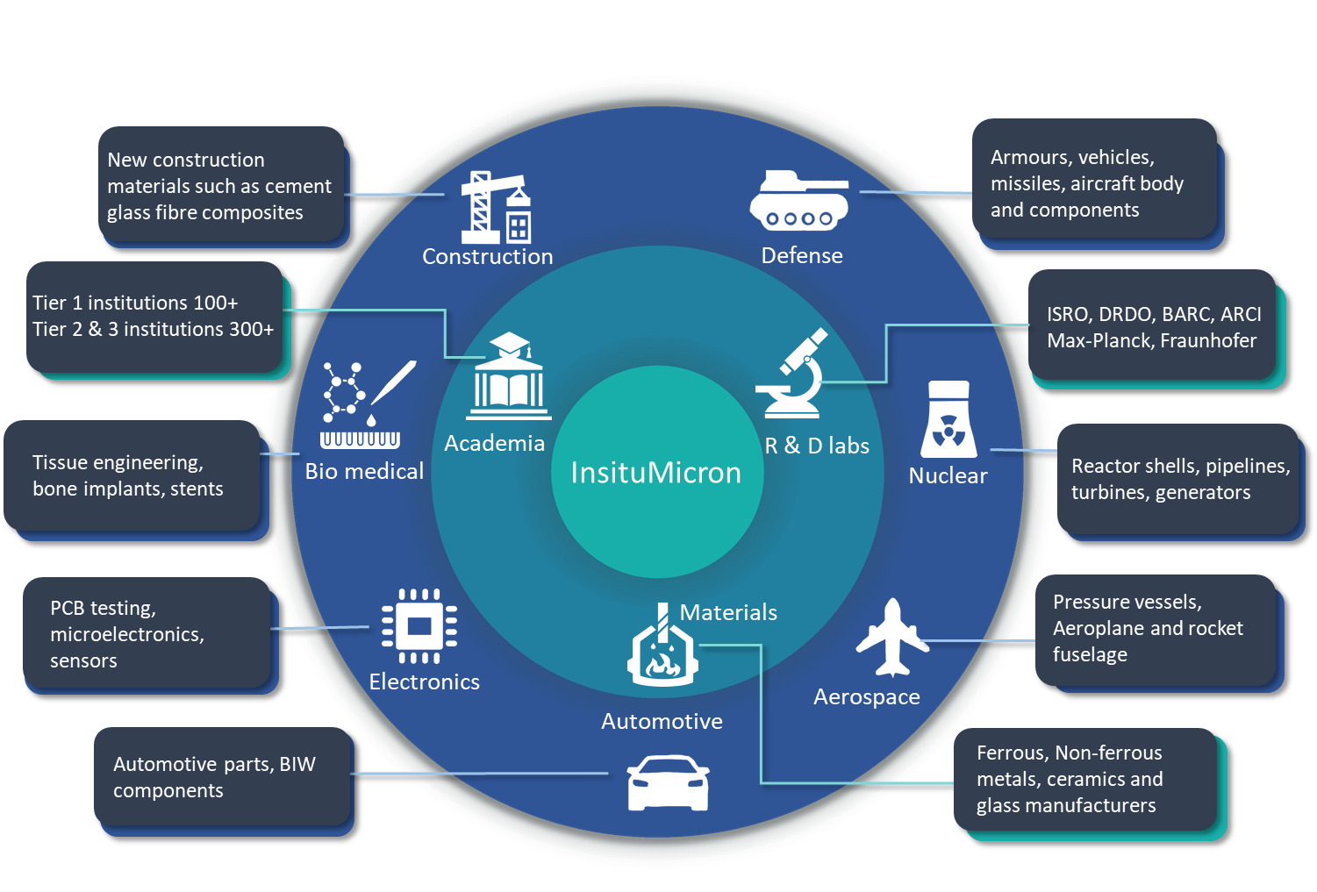
InsituMicron
Customer segments

Slide 13








Customer segments
New construction materials such as cement glass fibre composites
Armours, vehicles, missiles, aircraft body and components
Construction
Defense
Tier 1 institutions 100+
Tier 2 & 3 institutions 300+
ISRO, DRDO, BARC, ARCI
Max-Planck, Fraunhofer
Tissue engineering, bone implants, stents
Academia
R & D labs
Reactor shells, pipelines, turbines, generators
Bio medical
InsituMicron
Nuclear
PCB testing, microelectronics, sensors
Materials
Pressure vessels, Aeroplane and rocket fuselage
Electronics
Aerospace
Automotive
Automotive parts, BIW components
Ferrous, Non-ferrous metals, ceramics and glass manufacturers

Slide 14



InsituMicron
Present customers utilizing MUTE
Currently, Mr. Dhanasekaran, Deputy director for GSLV, VSSC has been carrying out biaxial experiments using the multiaxial universal testing equipment
Research groups requested for utilizing equipment include:
Prof. Anand Kanjarla, IIT Madras (Already utilizing)
Prof. Rajesh Prasad, IIT Delhi
Prof. Hariharan K, IIT Madras
Prof. Uday Chakkingal, IIT Madras
Prof. Subramanya Sarma V, IIT Madras

Slide 15
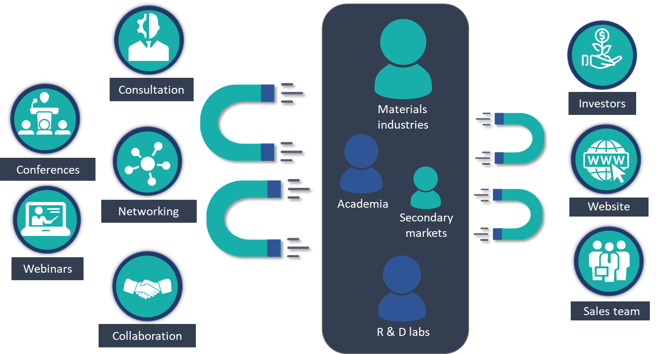
InsituMicron
Marketing strategy

Slide 16












InsituMicron
Business strategy
Miniature mechanical testing & in situ research community
Infinite and organic growth
Revenue segments
Sales and consultation
Compete internationally
Access to advanced facilities
Brand building
National & International
Product sales
Services
1
Collaboration
Solve more problems
Tier 2&3 universities and Industries
Tier 1 universities and national labs
Guidance from experts
2
Angel investors
Attract them with niche technologies and innovative products
3
Strategies
4
Government schemes
“Make in India/आत्मनिर्भर भारत” schemes and govt. projects
5
Data
Quality consciousness Perfection and reliable service
Enhanced consultation for industry
Predictive failure analysis - ML/AI Automation
Software enhancement for products

Slide 17






InsituMicron
Cost structure
Fixed costs
Variable costs
Infrastructure
Operational
Rent and utilities
Instruments used for consultation
Maintenance
Product sales
Transportation
Packaging
Other logistics
R & D
R&D employee salary
Research equipment
Service booking channels
Manufacturing
Raw material
Fabrication charges
Quality control
Services
Marketing
Variable wages
Sales team
Conducting workshops and conferences
Experts consultancy charges
Salary for service engineers
After sales service

Slide 18
InsituMicron
Revenue forecast
Instrument sales
Consultancy services

Slide 19





InsituMicron
Road Map
Improve aesthetics & sales of MUTE
Sign collaboration with academia and industries
Approach angel investors
R&D for new miniature testing and In situ products
Expand to other countries
Establish as a global leader in miniature mechanical testing and In situ characterization technologies
2023
2027
2022
2025
In situ & miniature mechanical testing of samples on payment basis
Consultancy for industries
Apply for government schemes and projects
Active recruitment for marketing and after sales support
Increase product portfolio
Begin development of next gen ML software's for failure analysis

